Slide 1
Capstone Project: The Battle of Neighborhoods
Buenos Aires edition

Slide 2
Brief description of Buenos Aires.
Buenos Aires, also known as Autonomous City of Buenos Aires, is the capital and largest city of Argentina with almost 3 million inhabitants (2,890,151 according to the 2010 census). The city is located on the western shore of the estuary of Río de la Plata, on the South American continent’s southeastern coast. The “Greater Buenos Aires” which includes also several Buenos Aires Province districts, constitutes the fourth-most popolus metropolitan area in the Americas, with a population of around 17 million, and one of the 20th biggest cities in the world. The city is historically divided into 48 barrios (neighborhoods) and a newer scheme has divided it into 15 comunas (communes) mainly for political elections purposes.
Buenos Aires is a cosmopolitan city and it’s also well known for it’s preserved Eclectic European Architecture and rich cultural life. Strongly influenced by European culture, Buenos Aires is sometimes referred to as the “Paris of South America”. The city has the busiest live theater industry in Latin America, and it’s the home the Teatro Colón, an internationally rated opera house. Buenos Aires is the financial, industrial and commercial hub of Argentina. The economy in the city proper alone, measured by Gross Geographic Product (adjusted for purchasing power), totaled US\\$84.7 billion (US\\$34,200 per capita) in 2011 and amounts to nearly a quarter of Argentina’s as a whole.
Football is a passion for Argentines. Buenos Aires has the highest concentration of football teams of any city in the world (featuring no fewer than 24 professional football teams), with many of it’s teams playing in the major league. The best-known rivalry is the one between River Plate and Boca Juniors (09/12/2018†), the match is better known as Superclásico. Watching a match between these two teams was deeemed one of the “50 sporting things you must do before you die” by The Observer. The best Superclásico ever was the historically final of the Copa Libertadores Championship, held on Santiago Bernabeu stadium on the 9th of december of 2018. River Plate won 3-1 and was crowned as the Copa Libertadores Champion.

Slide 3
1. Problem description.
Since the city is very populous and Traffic is usually terribly heavy, specially on working hours, people who lives in the city often likes to be close to work. Also, having parks, pharmacies, coffee-shops on other stores around is usually considered a plus. Buenos Aires is a relatively safe city to live in, if you compare it with other cities in Argentina and Latin America, but that does not mean that you don’t have to worry about security. On the contrary, is a issue that can not be avoided when moving around the city and choosing a neighborhood where to live. Also, rental prices are always a factor and there is much variation between neighborhoods.
The aim of this report is to analyze the barrios of Buenos Aires city, so I can decide where to move since I ‘ve been ofered a new position as a Data Scientist. I would have to work at Núñez Neighborhood if I accept it and I currently live on Boedo with my wife and kid. My wife likes the idea to moving towards Núñez because she is familiar with the sorroundings, and she would have her friends and relatives closer. In order to move, I would have to find an apartment with the following aspects:
Apartment with 2 bedrooms with monthly rent lower than $50.000 Argentinan Pesos.
Apartment located within approximately 1 km from a subway station in Buenos Aires. I go to work by mororcycle, so I don't use the subway very often, but it's must when it rains or in the coldest days of winter.
Neighborhood with low crime rate.
Area with venues similar to the ones described for current location.
Also, I will group Neighborhoods into similar clusters. That information can be used to find out neighborhoods that are same as your current neighborhood or at least similar. This information would be useful for people who are interested in relocating to a different part of the city and are interested in finding new neighborhoods that have similar venues to the ones in their current neighborhood.

Slide 4
2. Data Description.
DATASETS
1- Buenos Aires open data website (https://data.buenosaires.gob.ar/)
A) barrios.csv - Localization and geographical limits of city neighborhoods.
B) bocas-de-subte.csv – subway stations localization.
C) delitos_2019.csv – Localization of each crime registered in the city in 2019.
D) caba_pob_barrios_2010.csv – Population by Neighborhood.
2- Mercadolibre (https://www.mercadolibre.com.ar)
E) url0.csv to url24.csv – Since the Buenos Aires open data website has a data set about rental prices with more than 5000 missing values, it is useless for our purpose. To amend this we scrapped Mercadolibre web site and extracted with all the relevant information about two bedroom apartment rental notices in 25 csv files.
3- Open Street Data API and Foursquare API
I will request other data that can not be found in Buenos Aires Open Data website, like neighborhoods longitude and latitude coordinates.
I will locate different venues for the analyzed neighborhoods.

Slide 5
2.b How the data will be used to solve the problem
I will first load, clean and add variables to the data. I will be saving all the generated datasets for later use in the Section N#2
After Data Wrangling is done, the data will be used as follows:
Use Foursquare and geopy data to map top 10 venues for all Buenos Aires neighborhoods and clustered in groups.
Use Buenos Aires Open Data to map the location of subway stations, separately and on top of the above clustered map in order to be able to identify the venues and ammenities near each metro station, or explore each subway location separately.
Use Foursquare and geopy data to map the location of rental places, in some form, linked to the subway locations. create a map that depicts, for instance, the average rental price per square ft, around a radious of 1.0 mile (1.6 km) around each subway station - or a similar metrics. I will be able to quickly point to the popups to know the relative price per subway area. Addresses from rental locations will be converted to geodata( lat, long) using Geopy-distance and Nominatim. Data will be searched in open data sources if available, from real estate sites if open to reading, libraries or other government agencies such as Metro New York MTA, etc.

Slide 6
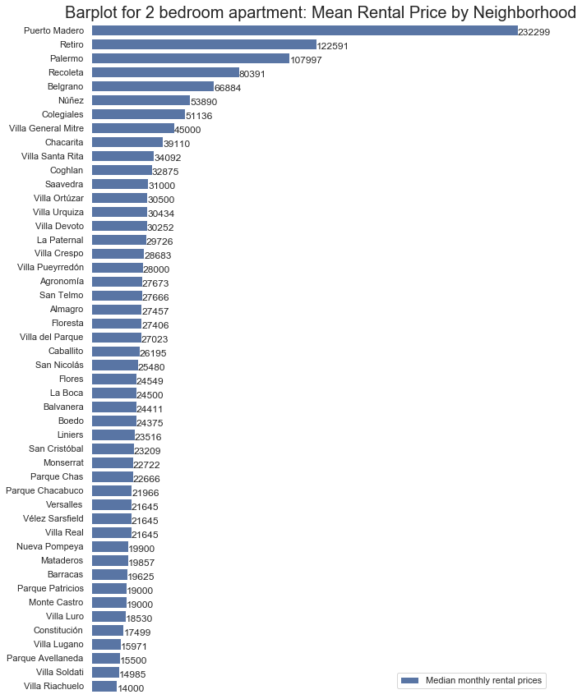
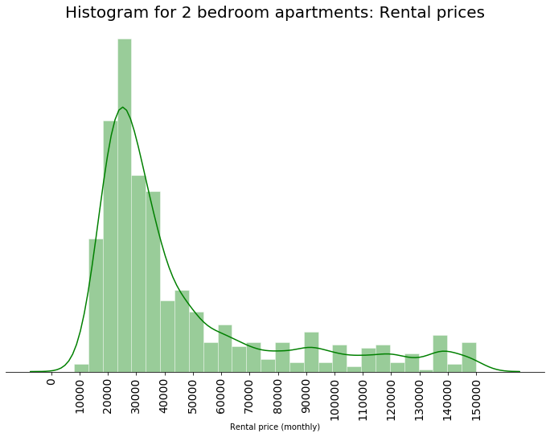
Data visualization

Slide 7
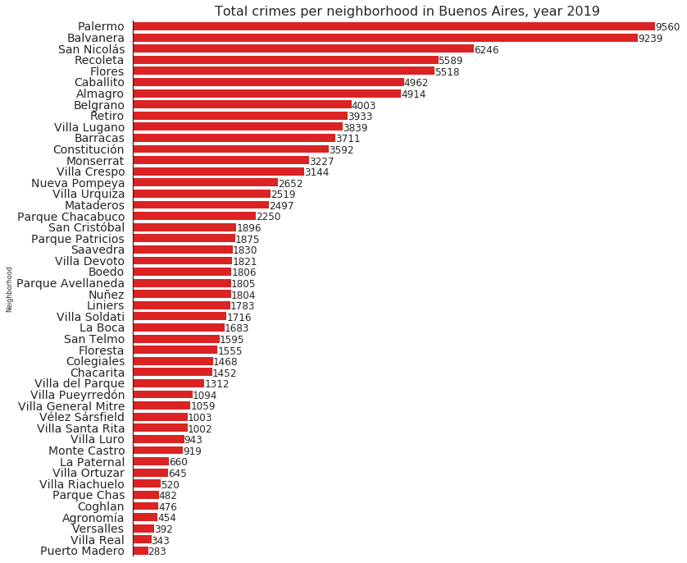
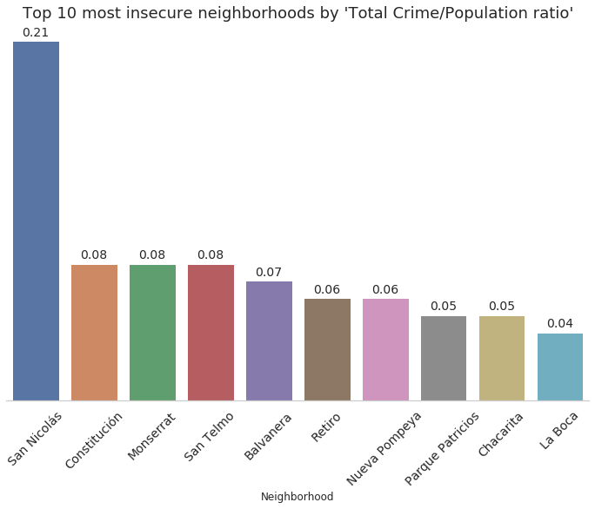
Data visualization

Slide 8
3. Methodology
The strategy was based on mapping some of the above described data(2. Data Description), in order to facilitate the choice of the candidate Neighborhoods and all the apartments that meet my criteria:
Apartment with 2 bedrooms with monthly rent lower than $50.000 Argentinan Pesos.
Apartment located within approximately 1 km from a subway station in Buenos Aires. I go to work by motorcycle, so I don't use the subway very often, but it's must when it rains or in the coldest days of winter.
Neighborhood with low crime rate.
Area with venues similar to the ones described for current location.
This visual approach with maps and popups labels allow quick identification of address and rental price, thus facilitating the process of searching and deciding.
I Currently reside in the neighborhood of 'Boedo' in Buenos Aires, about 10 minutes from downtown.
I used Foursquare to identify the venues around my apartment, which are then shown in the Buenos Aires map in methodology section. It can be used as a reference for comparison with the map of the candidates Neighborhoods.

Slide 9
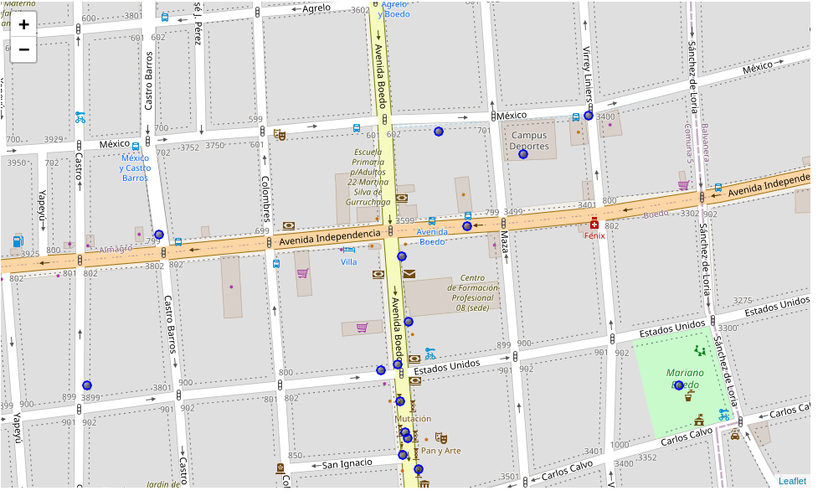
Map of my home surroundings with venues within 500 mts.

Slide 10
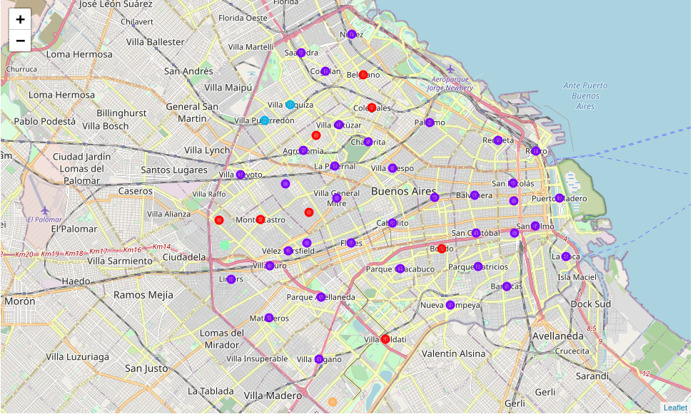
Buenos Aires neighborhoods normalized data with top 10 clustered venues.
Clusters was produced with normalized data from described sources and Foursquare data. Then they were superimposed to the map to the right.
Then I graphed available rental apartments and subway stations to search for candidates.

Slide 11
Clustering conclusions
Observing the characteristics of the clusters and their components, and being a native of Buenos Aires, I can draw some conclusions:
The the large differences in public green spaces (plazas, parks, natural reserves, etc) between the neighborhoods of Buenos Aires were not reflected by the Foursquare API. This is probably due to its low use by the local public.
More properties could be added to extend the characteristics of the neighborhoods and thus achieve a better classification. This would require intense data search and cleaning work, as well as web scraping, since the open data from Buenos Aires is scarce and of little granularity.
Despite the above, clusters provide important information, such as high or low crime, and allow establishing a first approach to finding an apartment according to the conditions detailed above (Cluster 0 looks promising).
From the upper map we can see that there are 3 Neighborhoods in cluster 0 (the red one) that are near to Núñez: Belgrano, Colegiales and Parque Chas.

Slide 12
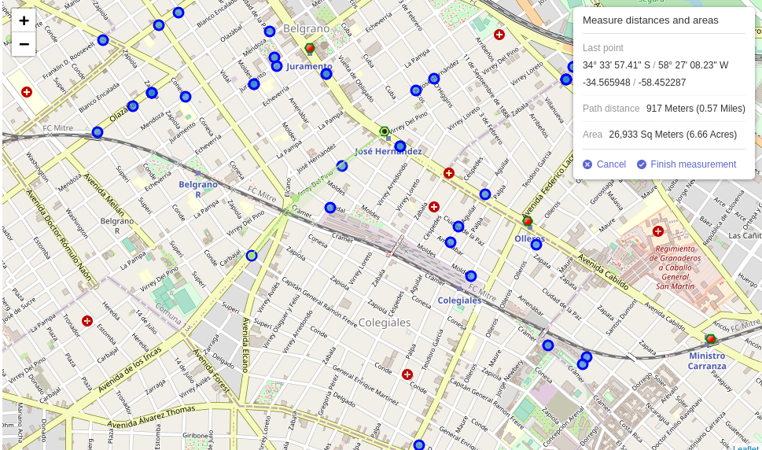
4. Results
- Available rental apartments(blue).
- Subway stations(red and green).
- Distance measurement (green line).

Slide 13
5. Problem Resolution.
Findings: Interesting 2 bedrooms apartments to look on
Belgrano Neighborhood:
$30000, Virrey Arredondo al 2200 , 90 Mts^2, near José Hernández station (108 Mts)
$31000, Virrey del Pino 2600 , 80 Mts^2, near José Hernández station (273 Mts)
$36000, Jose Hernandez 2000 , 80 Mts^2, near José Hernández station (455 Mts)
Colegiales Neighborhood:
$2400, cramer 355 , 70 Mts^2, near Olleros station (948 Mts)
$25000, av de los Incas 4400 , 60 Mts^2, near José Hernández station (921 Mts)
$26000, Olleros 2454 , 58 Mts^2, near Olleros station (178 Mts)
Parque Chas is not interesting because since I am going to travel to Núñez, when I need to use the subway, I should go west, crossing half the city, to combine with line H, and then combine with line D to return east. Nor are the prices or dimensions of the apartments tempting in relation to those seen in Belgrano and Colegiales. The interesting apartments in these neighborhoods are well below the \$50000 Argentinian pesos limit.They are ordered by lower price and coincidentally they are also ordered by proximity to the subway, with the exception of the apartment on Cramer Street. They are also ordered by larger size, although this was not a criterion. The "size" criterion was given by the number of bedrooms, in all cases dealing with two-bedroom apartments.

Slide 14
5. Final conclusion
As we observed previously, the three neighborhoods near Nuñez and the neighborhood in which I currently reside (Boedo) belong to the same cluster. Their similarity, since the creation of clusters is based on the creation of groups of homogeneous elements, was a good news since we are confident they have similar values on their features and similar venues. The data shows that there are more crimes in Boedo than in the three selected neighborhoods, although Colegiales and Belgrano have higher rental prices on average. The latter is not a problem since we established a maximum price criterion and I did find interesting apartments quite below that range.
Throughout this presentation I described the proposed objective: Explore the neighborhoods of Buenos Aires, make clusters and map apartments for rent according to the criteria we established at the beginning. I achieved this with a lot of effort and dedication, especially in the data wrangling part, since the city data presented difficulties and shortcomings. I were able to do web scraping to get rental prices and map the clusters, rental apartments and subway stations.
Finally I invite all readers to consult the complete code: https://github.com/MMarcelo85/AppliedDScapstone-IBM-coursera/blob/master/Capstone%20Project%20-%20The%20Battle%20of%20Neighborhoods%20Bs%20As%20edition%20-%20Full%20code.ipynb
Limitations
The ranking is based on few features and FourSquare API has few venues to offer to most of Buenos Aires Neighborhoods.

